Slide 1
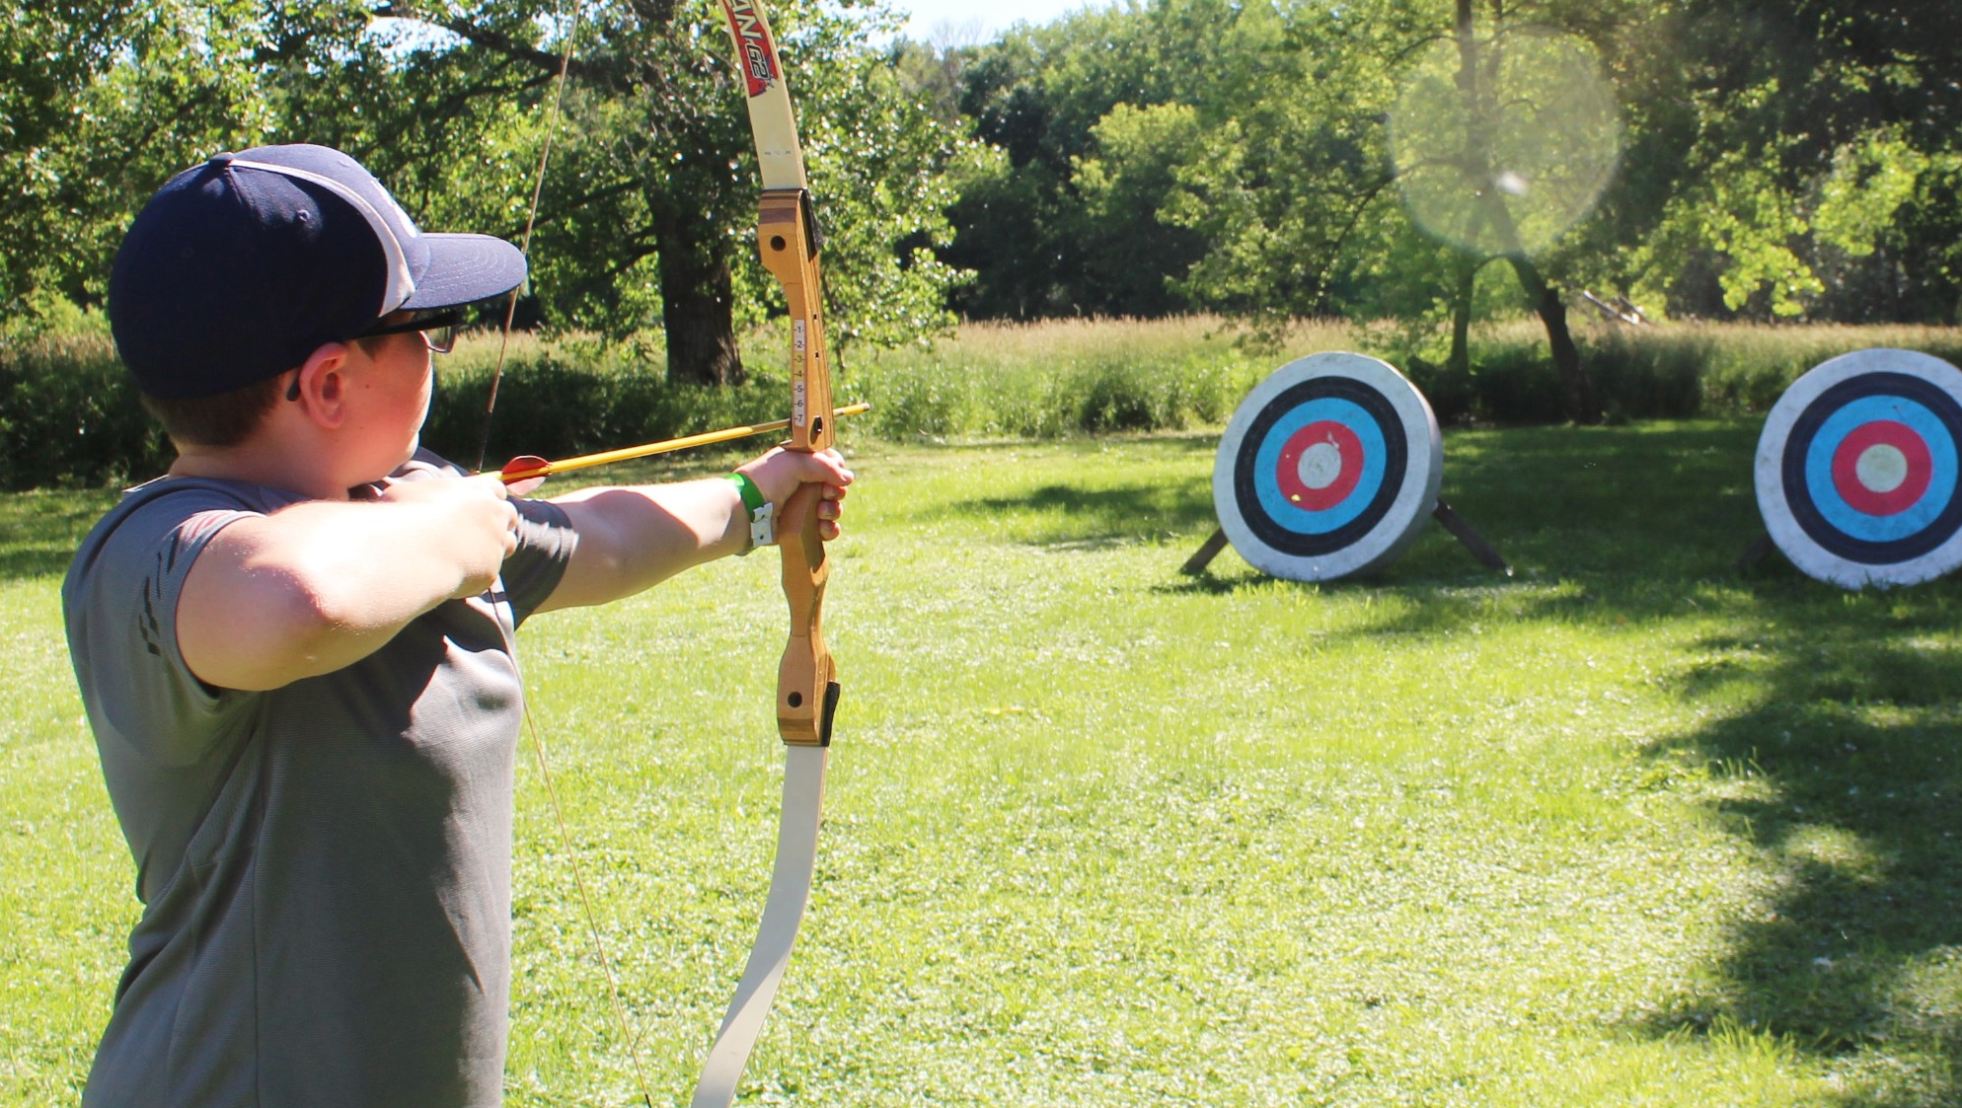
JOIN US FOR
SUMMER
CAMP
2021
INGHAM OKOBOJI LUTHERAN BIBLE CAMPS
WWW.OKOBOJI.ORG | 1-800-OKOBOJI

